Slide 1




Home
About
Service
BRIDGING THE GAP: REAL-WORLD TECH JOBS VS. ACADEMIA
Scraping, Modeling & Insights Across 7 Global Platforms
Ali Ahmed Sherif
Abdelrahman el Sherif

Slide 2











Slide 3

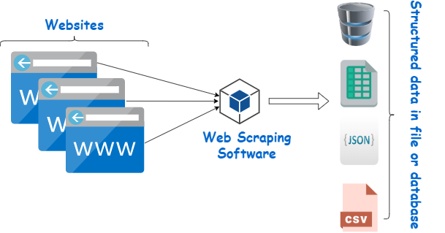
Home
About
Content
Others
OUR MISSION
Build an end-to-end pipeline from scraping to insights to illuminate where the market really is.

Slide 4

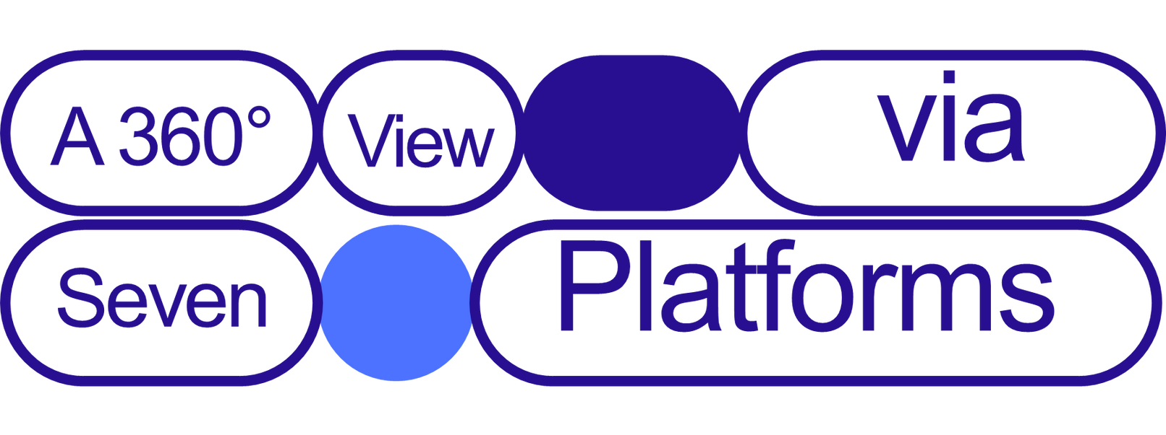
Page 10
-

Slide 5

Job boards & freelancing
Regional specialist
Layoffs tracker
•Upwork
•Wuzzuf
•Indeed
•RemoteOK
•Monster.com
EgyTech
TechLayoffs dataset
Why These
•Global freelancing vs. traditional jobs
•Developed (USA, Europe) vs. emerging markets (Egypt, India)
•Hiring & layoffs in one place
-

Slide 6


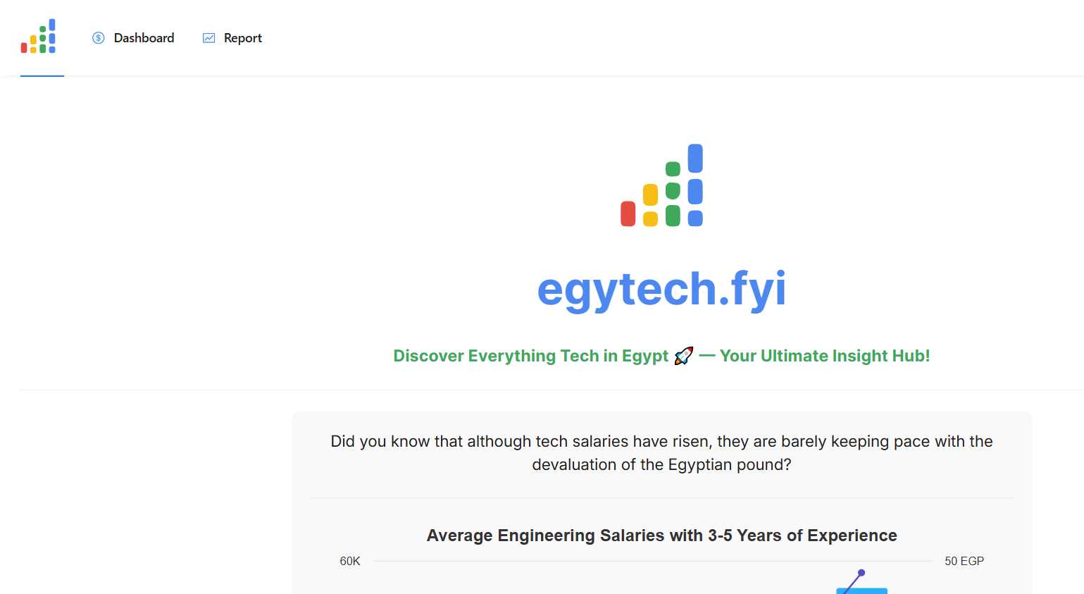
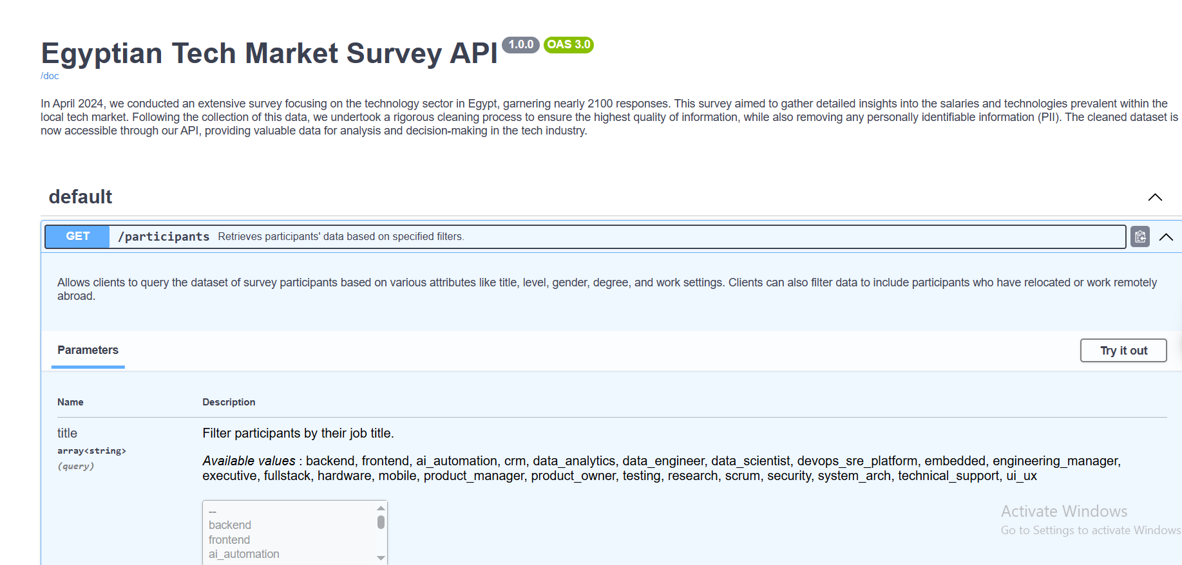
EGYTECH (HTTPS://EGYTECH.FYI)

Slide 7



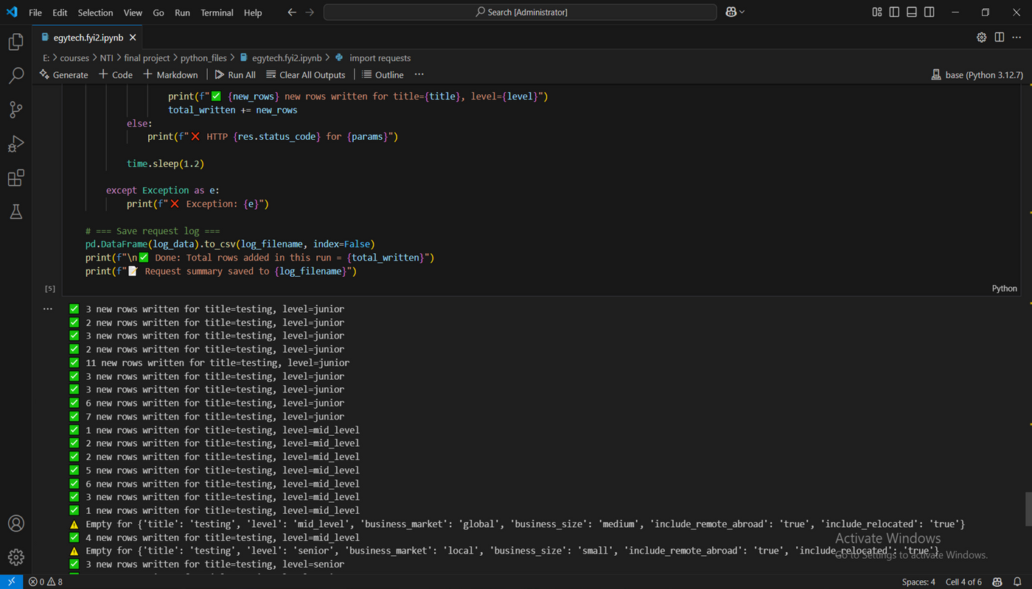
EGYTECH (HTTPS://EGYTECH.FYI)

Slide 8
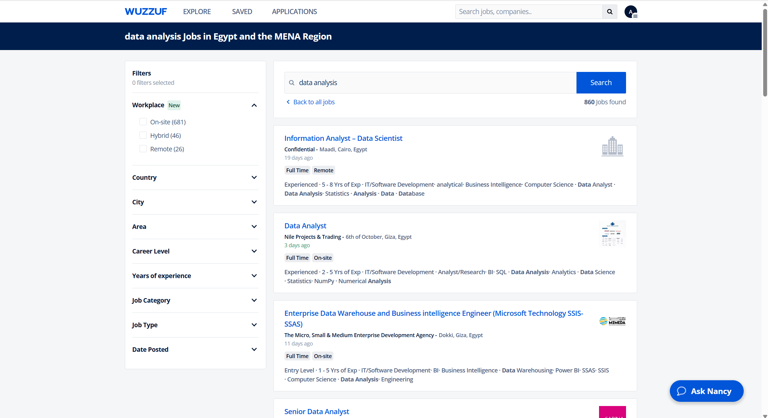
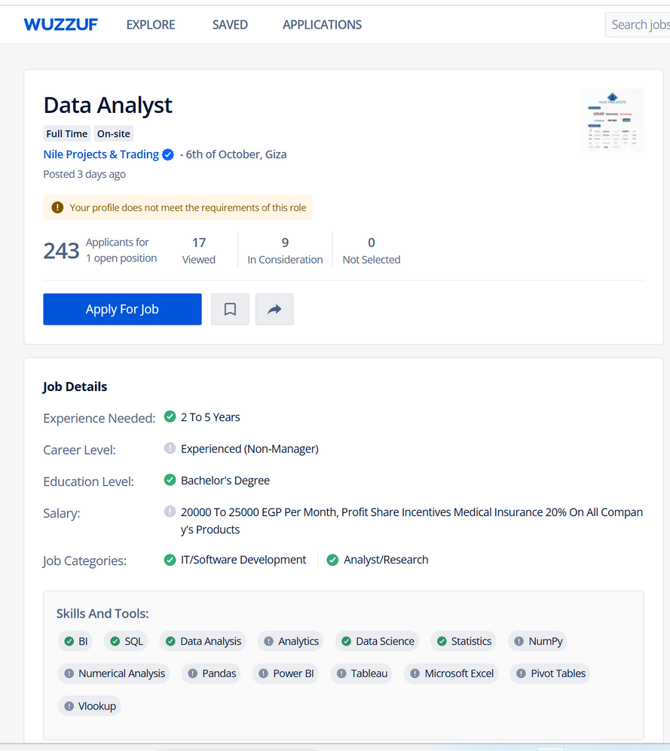


WUZZUF (HTTPS://WUZZUF.NET)

Slide 9


Slide 10

Home
About
Content
DATA CLEANING & NORMALIZATION
•Text normalization: UTF-8 issues, stop-word removal, description-based title mapping
•Salary unification: Hourly ↔ annual conversions, budget vs. range
•Job title taxonomy: 60+ roles collapsed into 50 standardized titles (AI Engineer, Data Analyst…)
•Experience buckets: From “0–1” up to “>15” → Entry, Junior, Mid, Senior, Lead, Expert

Slide 11

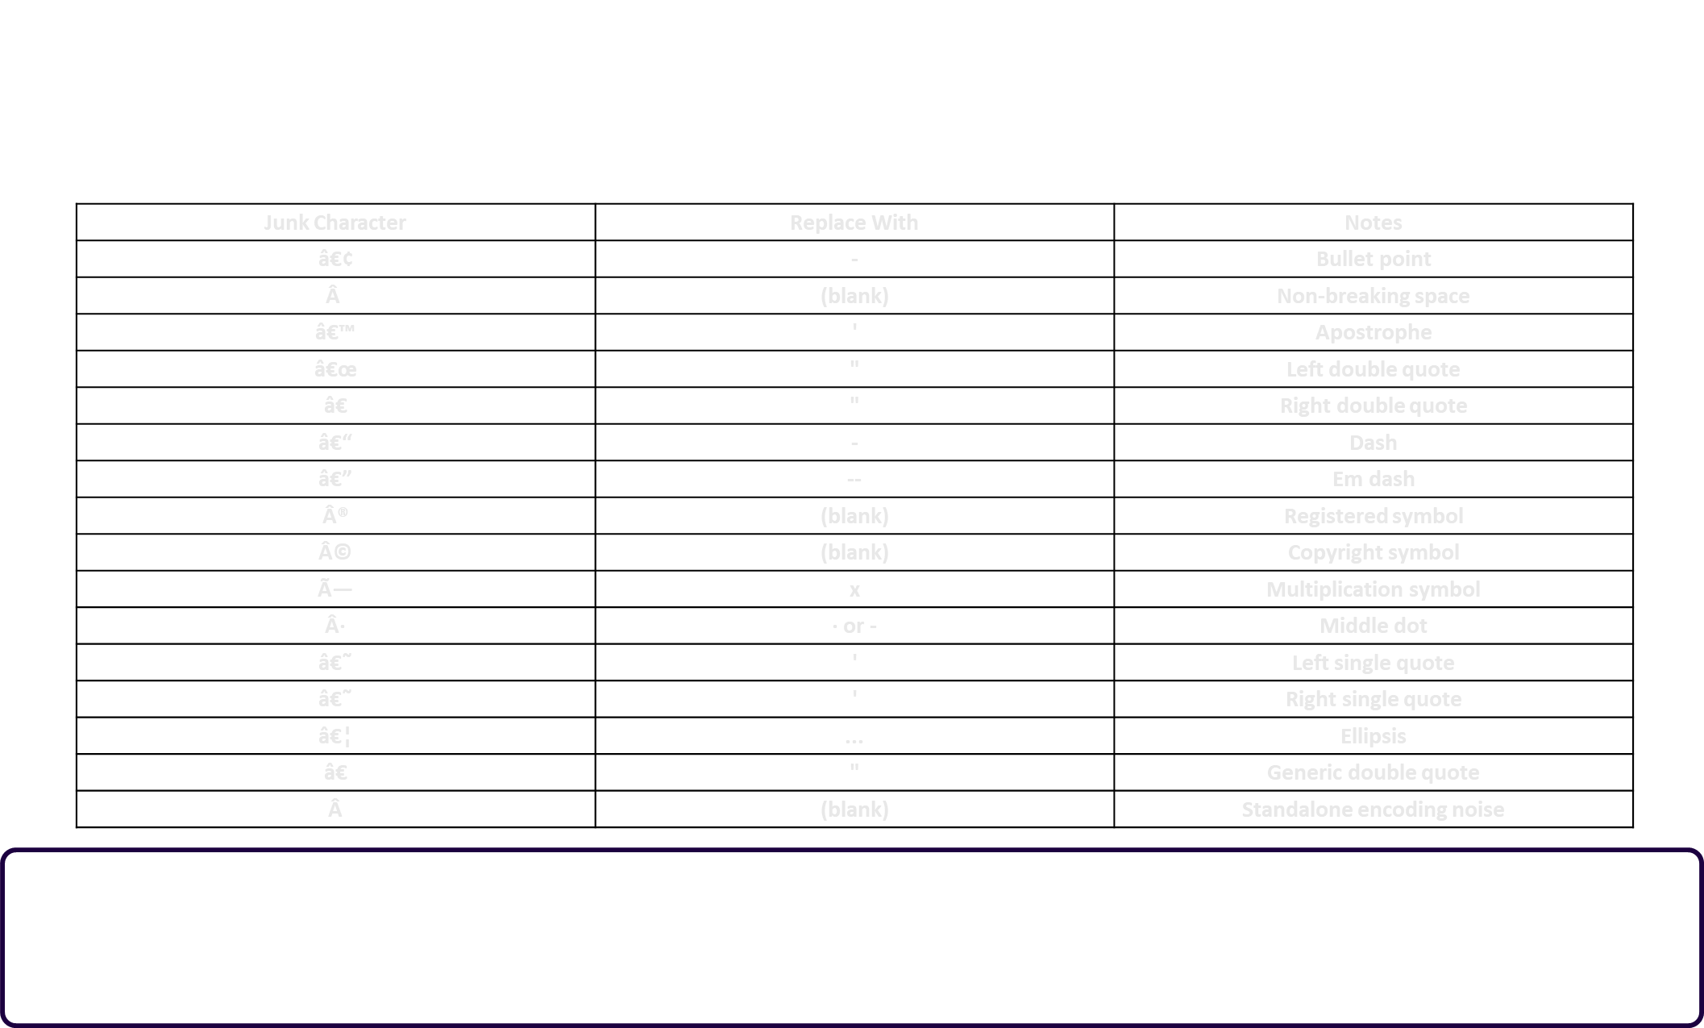
Thynk Unlimited

Slide 12




Standarizing Job Titles on all Datasets

Slide 13

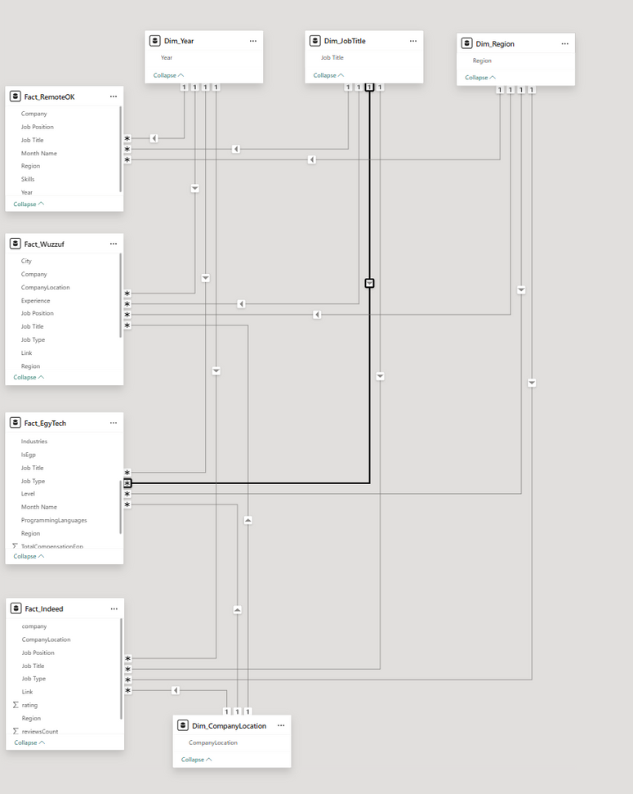
GALAXY(CONSTELLATION)SCHEMAS
Separation of Concerns:
•Job-posting metrics (counts, salaries) kept separate from layoffs metrics.
•You avoid mixing incompatible measures in one fact.
Reusability of Dimensions:
•One dim_JobTitle feeds all facts—so you compare roles across platforms.
•One dim_Date anchors all time-series analyses in sync.
Performance & Clarity:
•Each fact table stays lean (only its measures + FKs).
•Model view remains clear: you can see each star’s shape and shared dims.

Slide 14
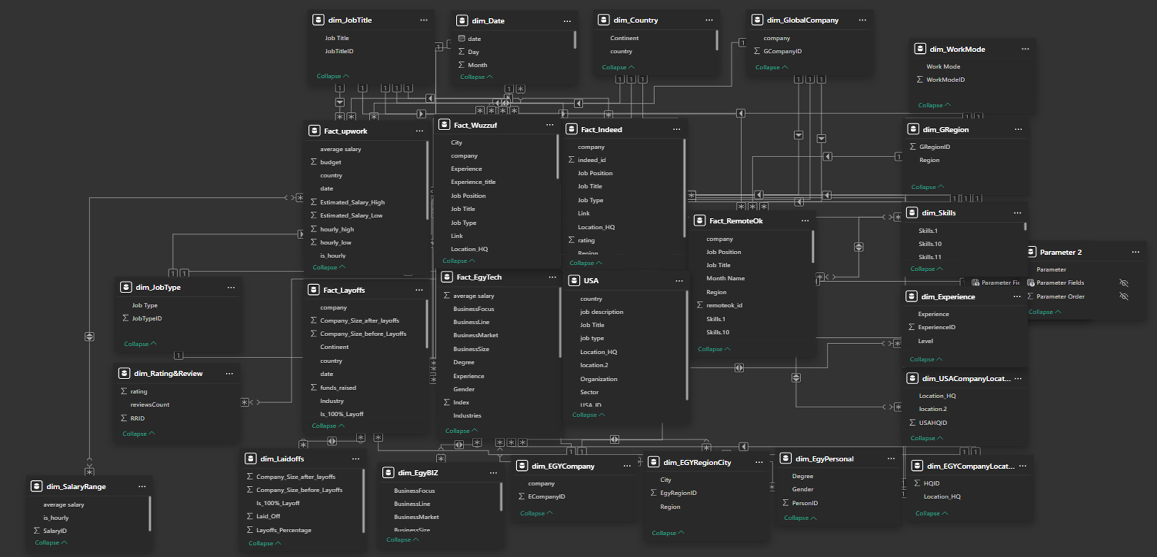
GALAXY(CONSTELLATION)SCHEMAS

Slide 15
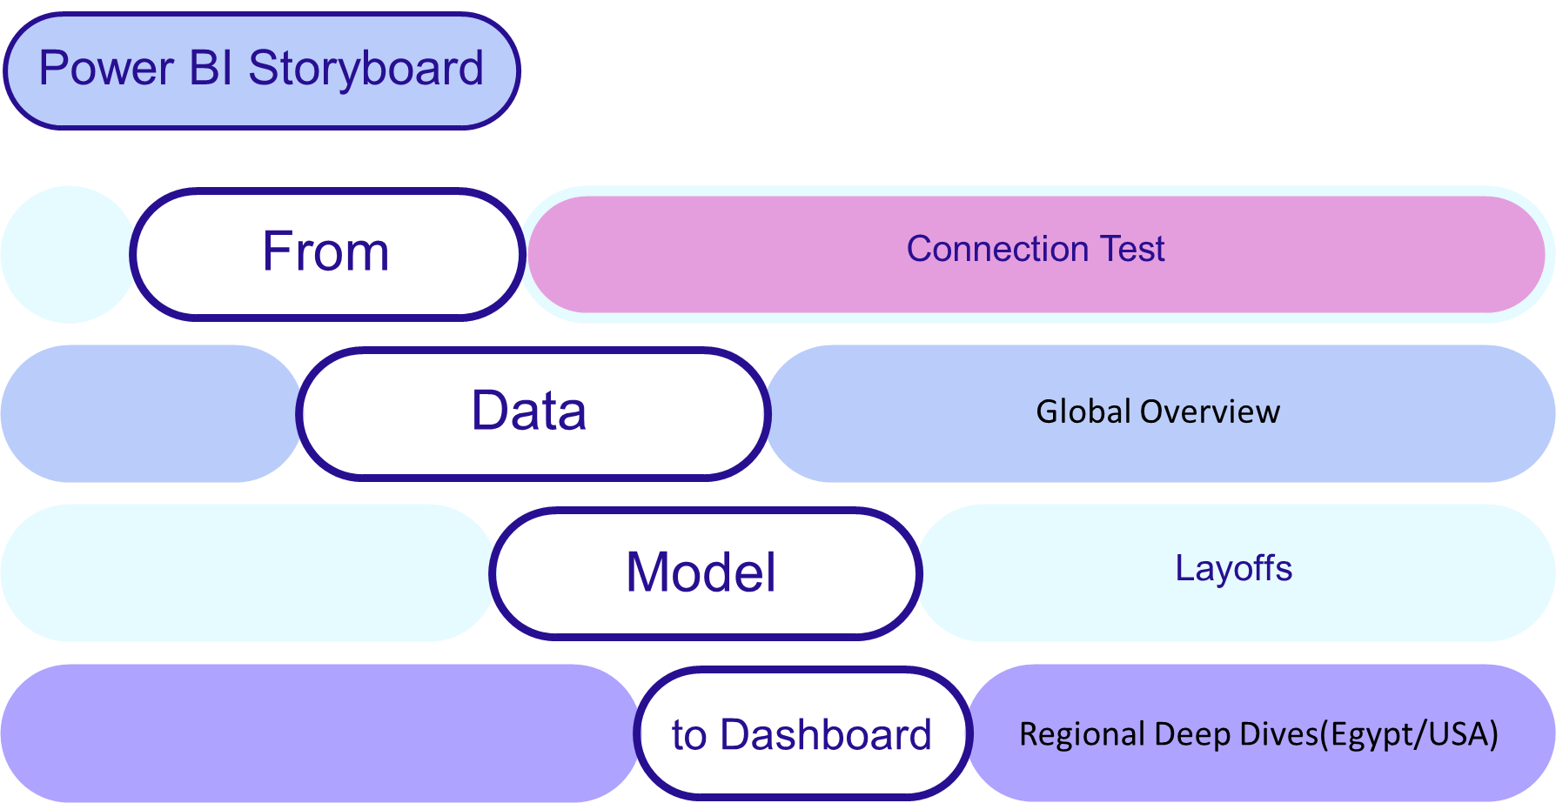
-

Slide 16
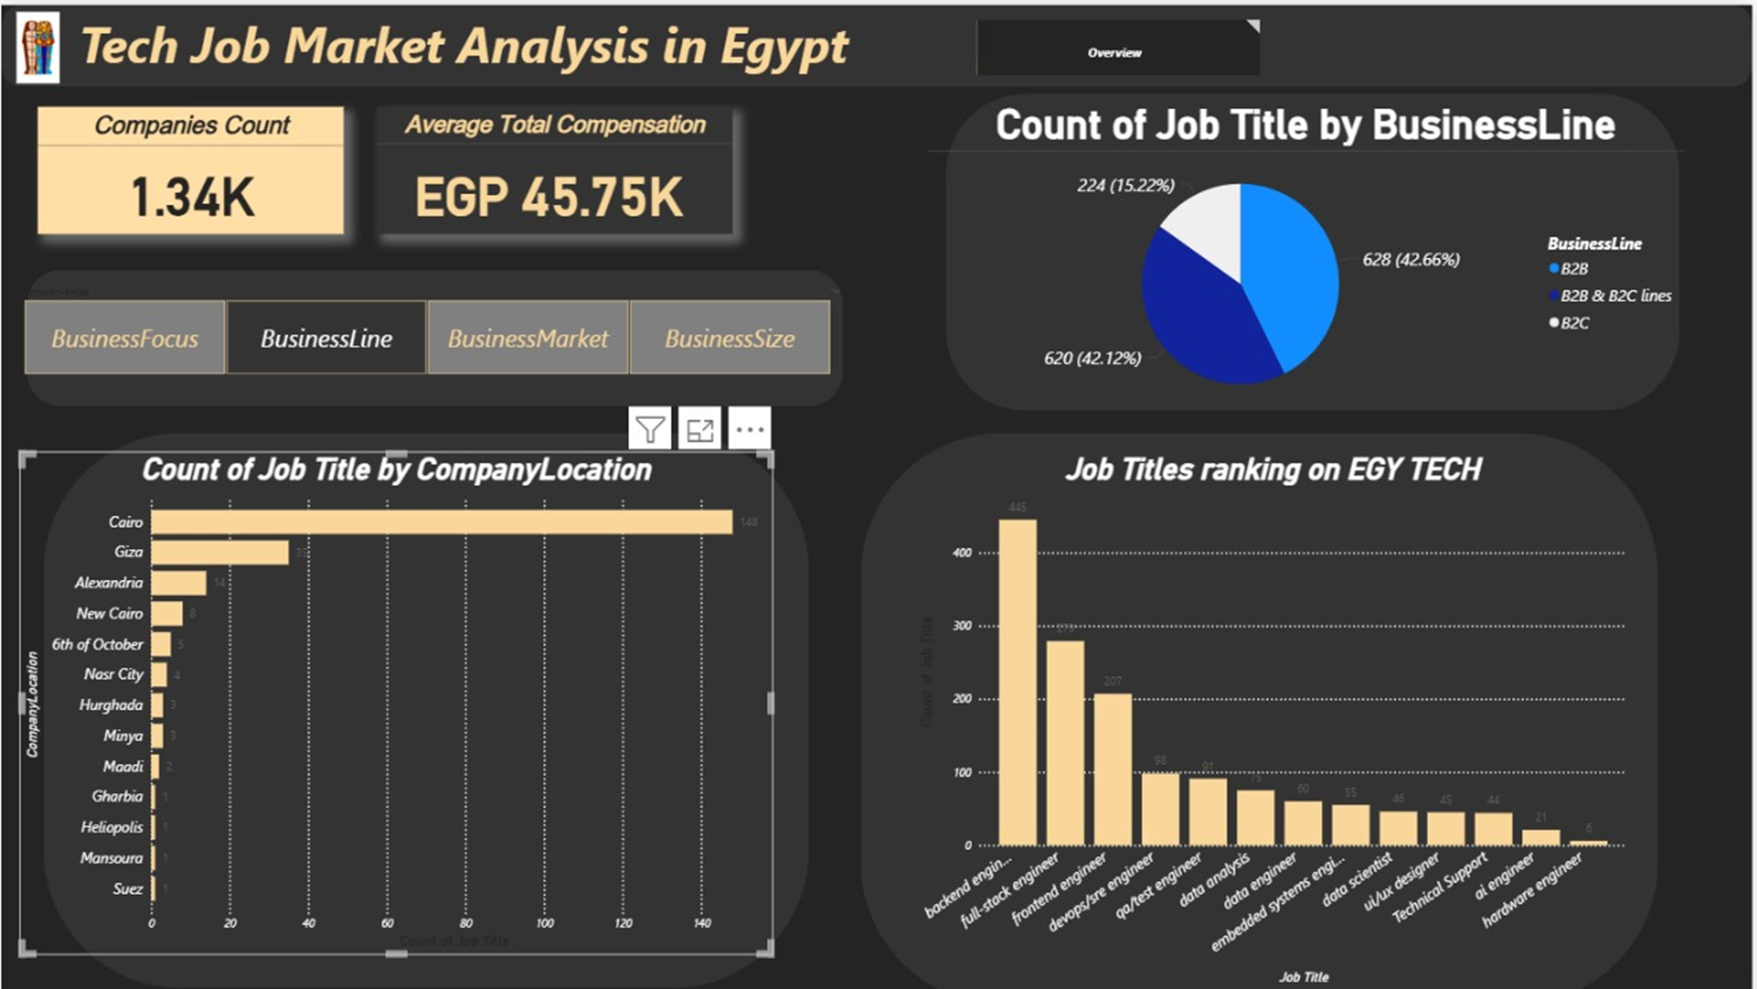

Slide 17
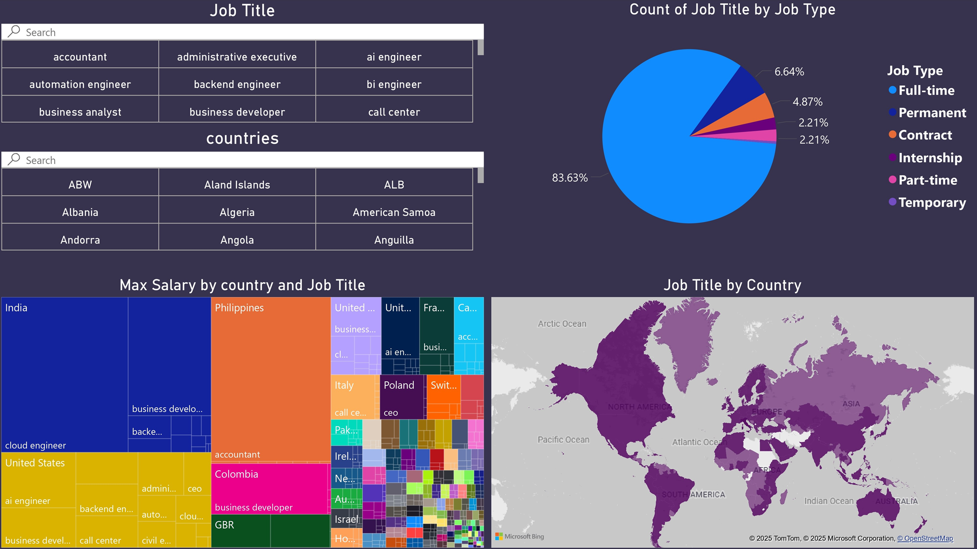

Slide 18
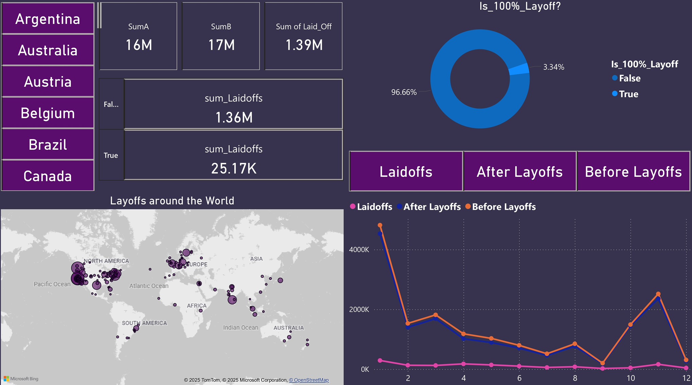

Slide 19
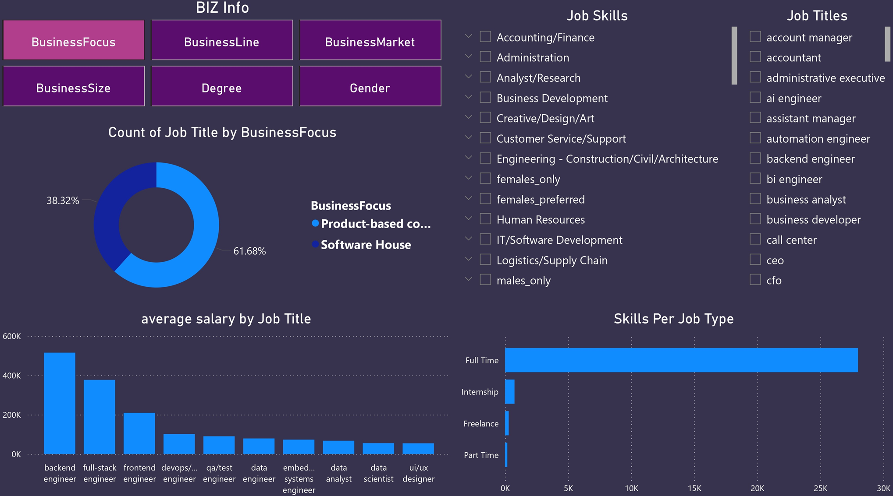

Slide 20
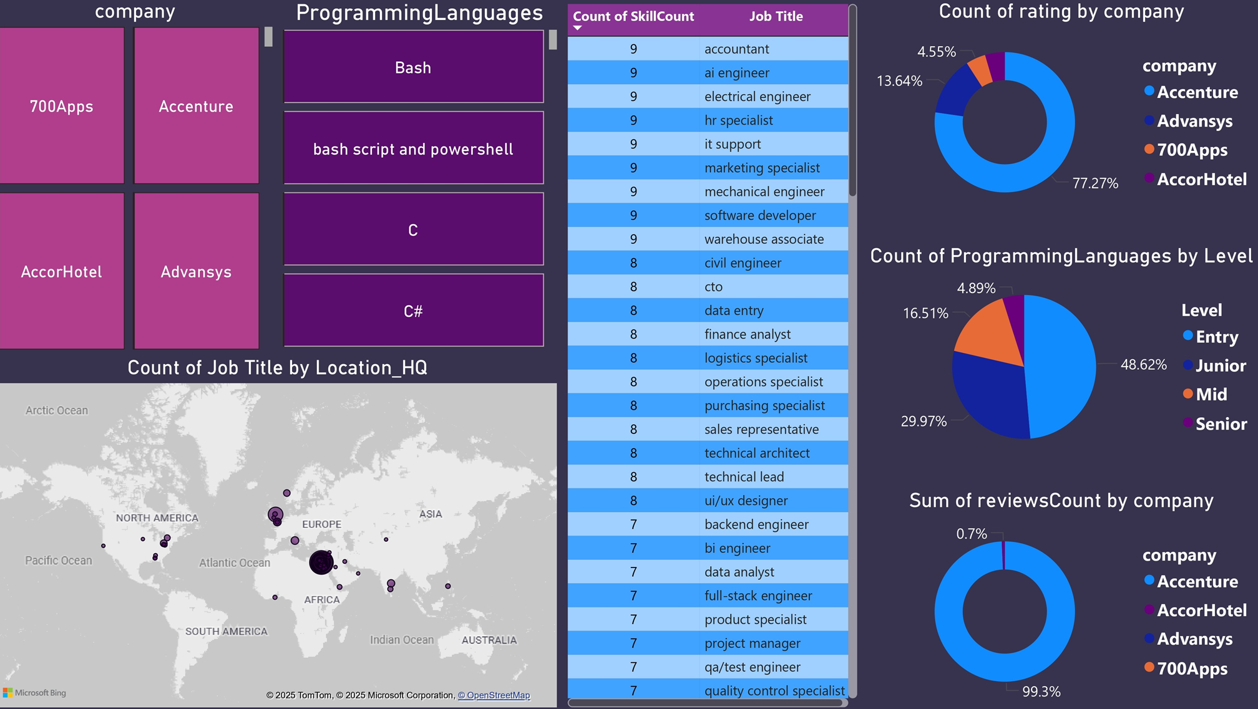

Slide 21
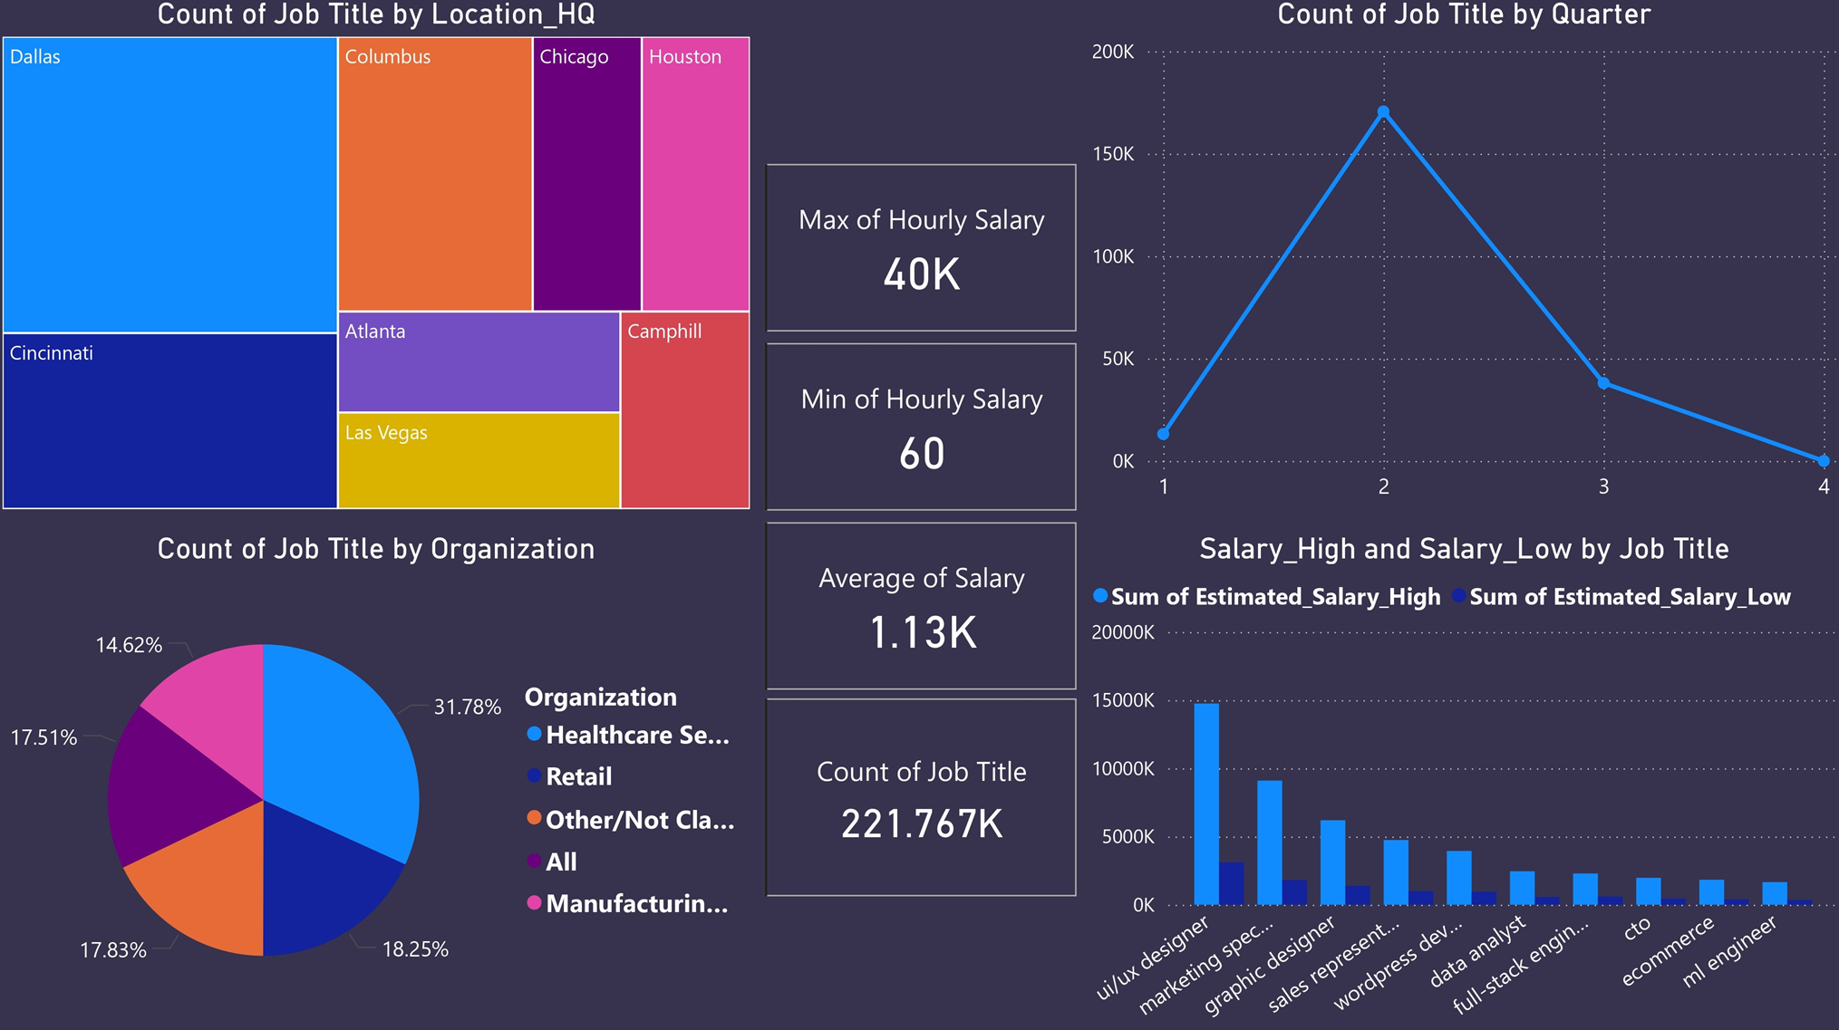

Slide 22
GLOBAL MARKET HIGHLIGHTS
•Top Paying Country for Cloud Engineers: India offers the highest global salaries for Cloud Engineers.
•Lowest Global Salaries: Found in Aruba (ABW), particularly for Graphic Designers.
•Highest Average Salaries by Country: Business Development roles in the UK (GBR) show the highest average salaries.
•Best Countries for Data Analysts: The United States leads, followed by Germany and the United Kingdom.
•Job Types: 83.63% of global jobs are Full-Time roles.
•Layoffs Analysis (Past 5 Years):
•Total layoffs: 1.4 million employees.
•100% company-wide layoffs: 25,170 employees (~3.4%).
•The majority of layoffs occurred in the USA.

Slide 23



EGYPTIAN TECH MARKET INSIGHTS
•Company Size:
•Small & Medium: 35.33%
•Large & Enterprise: 34.71%
•Startups: 29.96%
•Workforce Profile:
•Degree Holders: 78.94%
•Non-Degree Holders: 21.06%
•Gender: 79.62% Men, 20.38% Women
•AI Engineers require the highest number of technical skills.
•Top Employer on Indeed (by reviews and ratings): Accenture
•Top 10 Highest Paying Job Titles:
•Backend Developer
•Full Stack Developer
•Frontend Developer
•DevOps Engineer
•QA Engineer
•Data Engineer
•Embedded Systems Engineer
•Data Analyst
•Data Scientist
•UI/UX Designer
•Business Focus:
•Product-Based: 61.68%
•Software Houses: 38.32%
•Business Model:
•B2B: 42.66%
•B2B & B2C: 42.12%
•B2C: 15.22%
•Market Orientation:
•Global: 41.44%
•Regional: 40.9%
•Local: 17.66%

Slide 24
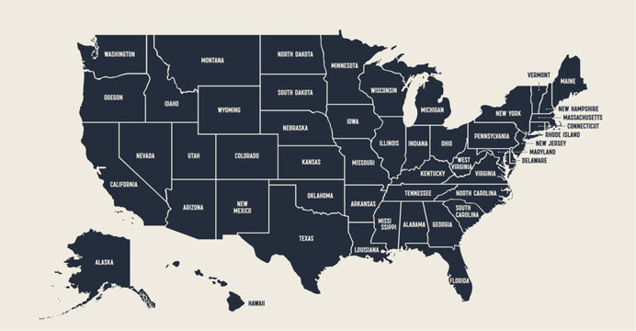
UNITED STATES JOB MARKET INSIGHTS
•Highest Hourly Salary: $40,000
•Lowest Hourly Salary: $60
•Average Salary: $1,130
•Total Job Count: 221,760 listings
•Peak Hiring Season: Second Quarter (Q2) of the year
•Top Hiring City: Dallas
•Dominant Sector: Healthcare Services
•Highest Paying Roles:
•1st: UI/UX Designers
•6th: Data Analysts

Slide 25
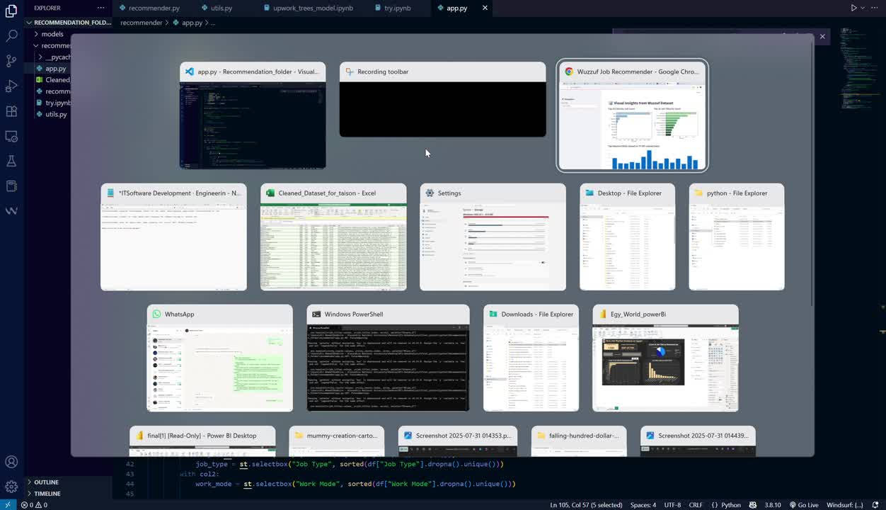

Slide 26
THANK
YOU
-

